Slide 1

Play Again
Game Over!
Great Job! Level Complete

Slide 2


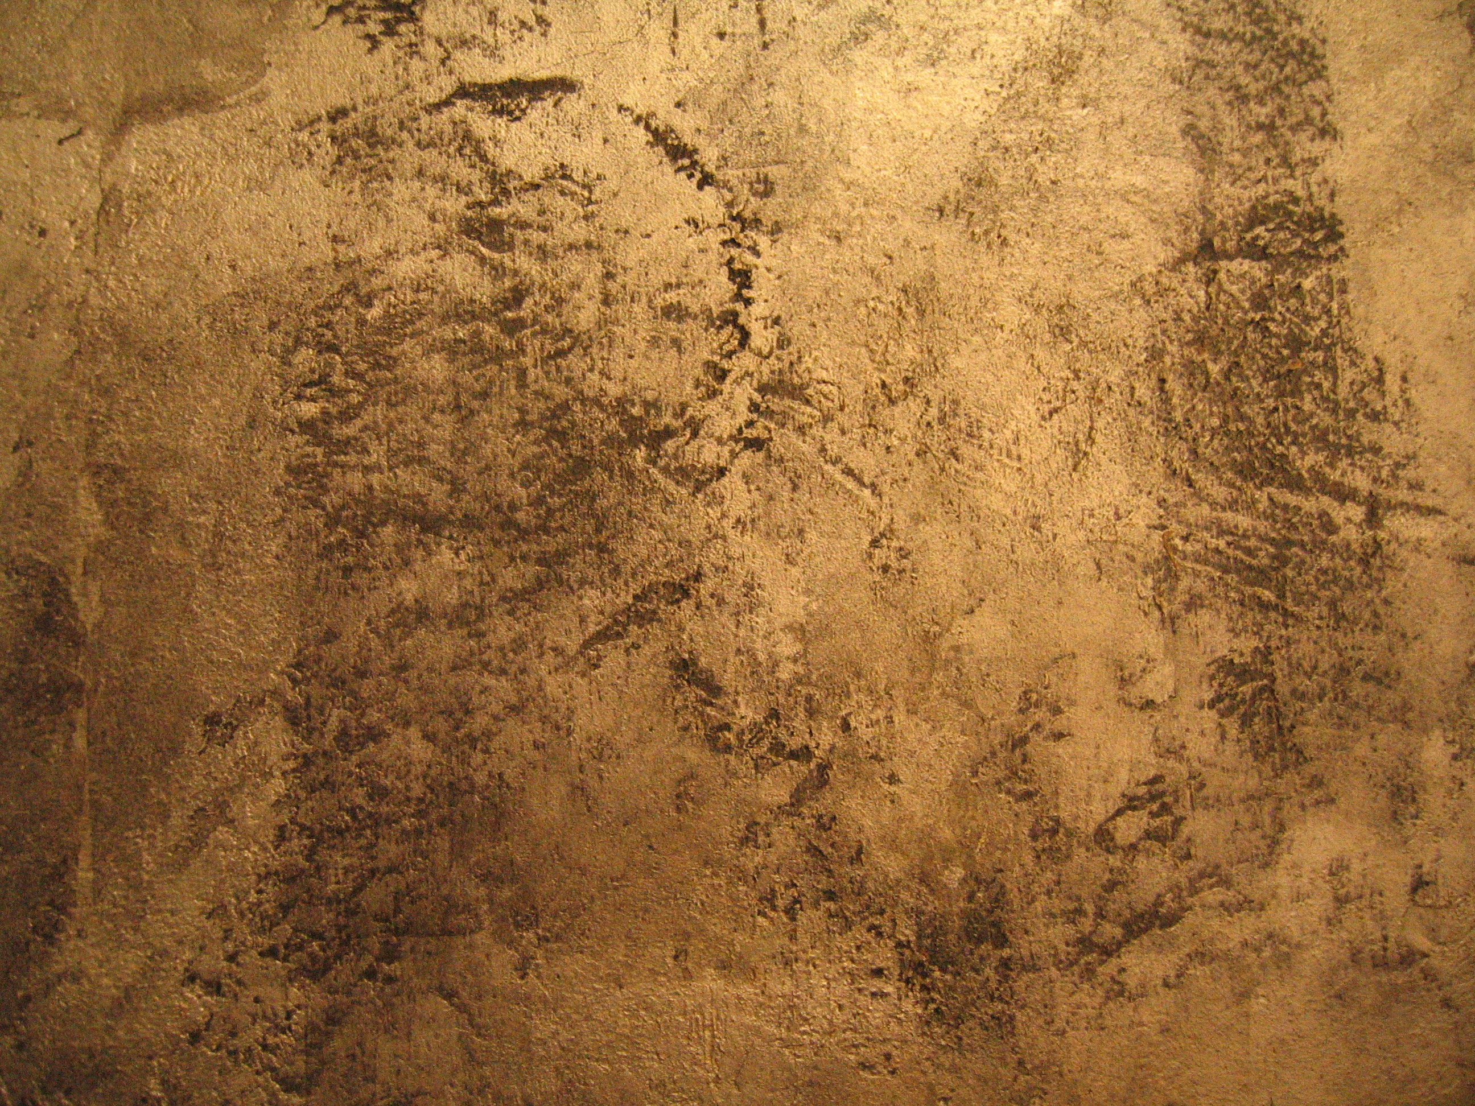
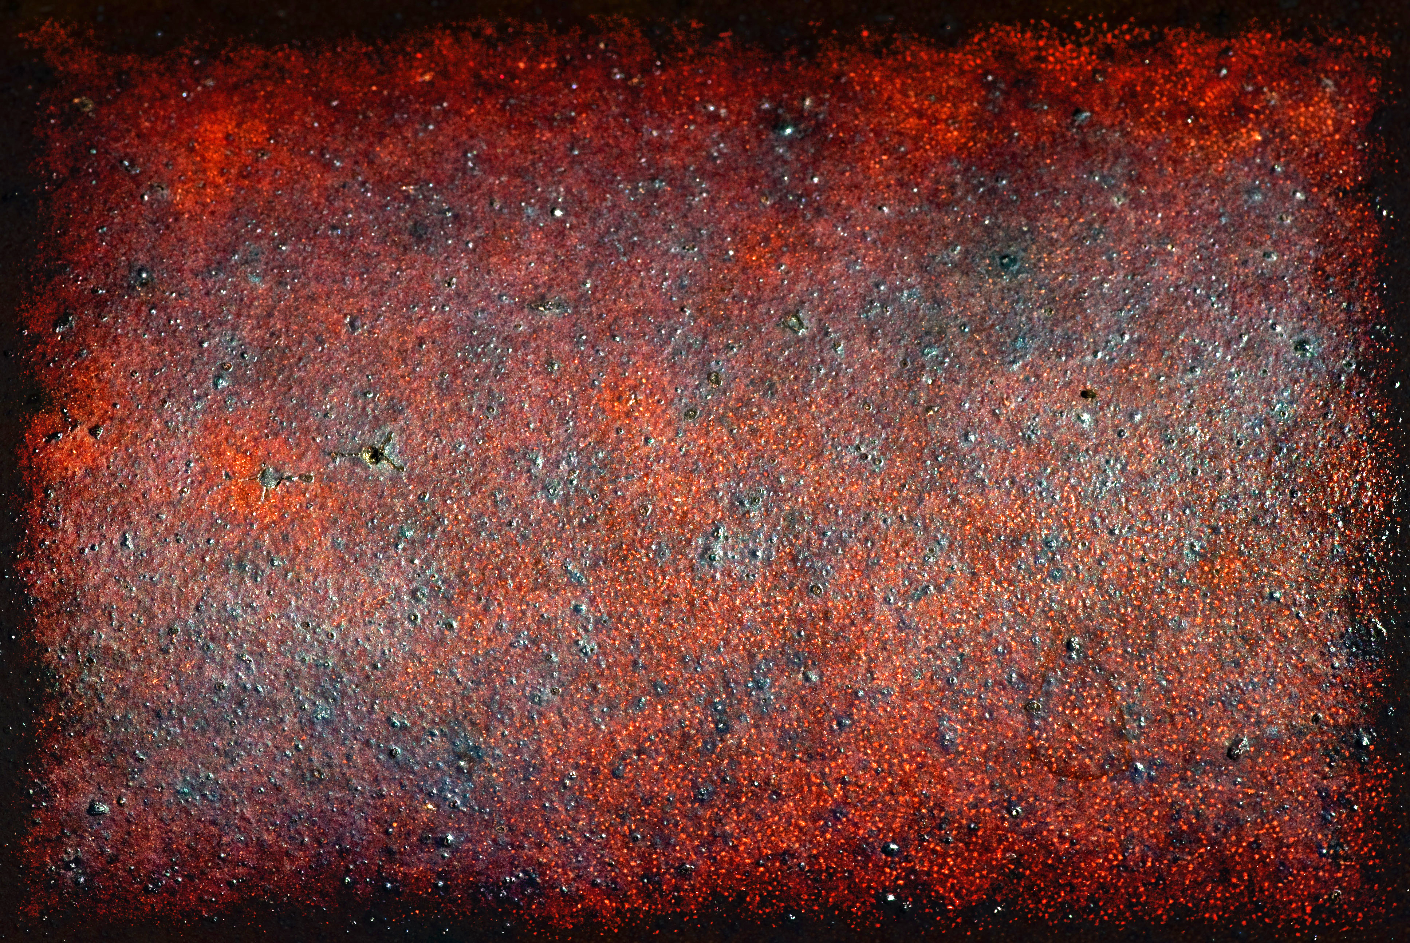

Slide 3

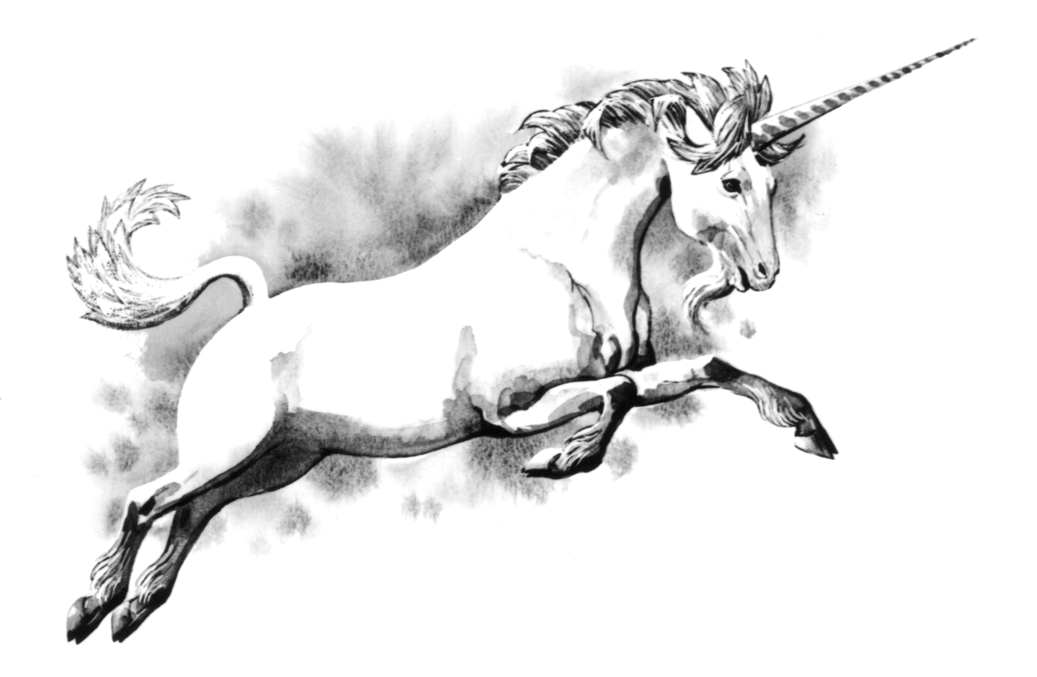
Binary Bastards

